Slide 1
Financial Performance Review & FY2020 Outlook
Comprehensive Analysis of Historical Trends, Key Variances, and Strategic Insights
By Varsha Pathinti

Slide 2
Project Overview
This project analyzes a company’s financial performance through the preparation and interpretation of key financial statements. Using structured synthetic data, I built the Profit & Loss Statement and Balance Sheet to evaluate revenue trends, profitability, and financial stability. The insights were visualized in Power BI, simulating a real-world FP&A process - from financial modeling to actionable business insights that help management assess performance, control costs, and plan for growth.

Slide 3
Financial Framework & Approach
Data Preparation: Collected and cleaned financial data in Excel for accuracy
Modeling: Linked P&L, Balance Sheet, and key ratios to understand financial performance.
Analysis: Performed trend and variance analysis to find what’s driving results.
Visualization: Used Power BI to present insights clearly for business decisions.

Slide 4
Project Workflow
Data Collection
Data Cleaning
Model Building
Analysis
Visualization
Decision Support

Slide 5
KPIs & Main Line Items
Revenue Growth – Tracks sales performance and overall business momentum.
Gross Profit Margin – Measures operational efficiency and cost control.
Operating Profit (EBITDA) – Evaluates profitability before non-operational costs.
Net Profit Margin – Reflects overall profitability after all expenses.
Current Ratio – Indicates liquidity and short-term financial health.
Debt-to-Equity Ratio – Assesses leverage and financial stability.

Slide 6
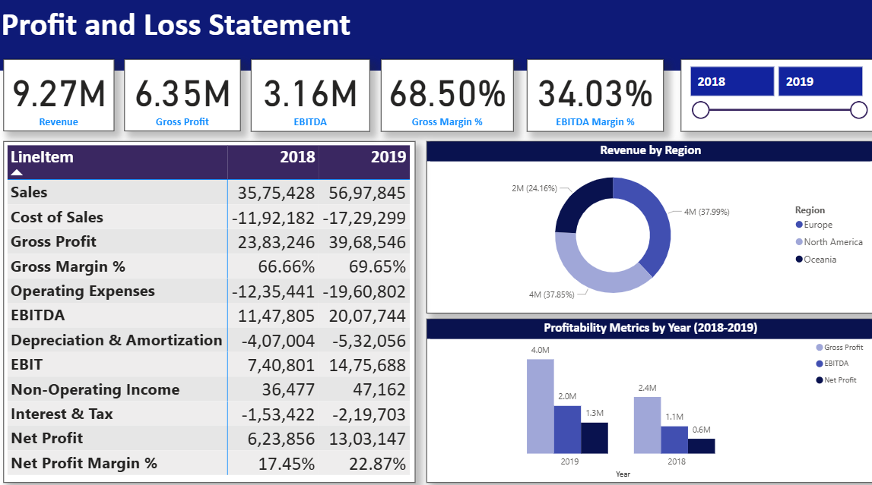
Profit & Loss Dashboard

Slide 7
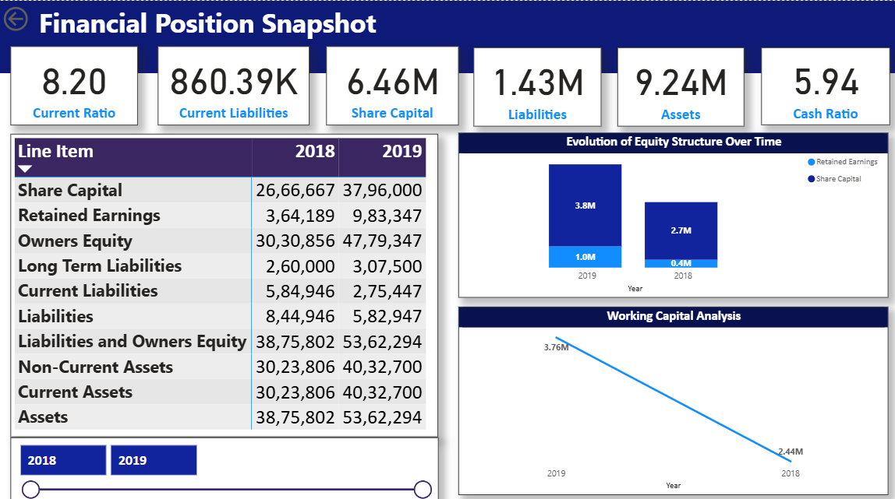
Balance Sheet Dashboard

Slide 8
Key Insights
Revenue & Profitability: The company maintained steady revenue growth with improved operating margins, indicating efficient cost management.
Expense Control: Operating expenses remained proportionate to revenue, showing strong expense discipline.
Asset Efficiency: Assets are utilized effectively, reflecting healthy turnover and capital allocation.
Liquidity Position: A stable current ratio indicates that short-term obligations are well-managed
Financial Stability: Lower debt dependency and consistent equity growth highlight long-term financial strength.

Slide 9
Recommendations
Optimize Operating Costs: Continue monitoring expense trends to sustain profitability as revenue scales
Strengthen Working Capital: Maintain efficient receivables and payables cycles to ensure liquidity.
Leverage Dashboards for Decisions: Use Power BI visuals for monthly performance tracking and management reviews.
Monitor Key Ratios Regularly: Track profitability and leverage ratios to ensure financial stability.
Invest in Growth Areas: Allocate more capital to high-margin or high-growth segments identified in the analysis.

Slide 10
Conclusion
This project demonstrates how financial planning and analysis can transform raw financial data into strategic business insights. By integrating Excel-based modeling with Power BI dashboards, the project provides a clear picture of profitability, efficiency, and financial health. It highlights the importance of data-driven decision-making, enabling management to plan effectively, control costs, and drive sustainable growth.

